Slide 1
Chatbots
aka.ms/RocAzure
October 2018
Trey Talbott Mike McKechney Anthony Martin
trey.talbott@microsoft.com michael.mckechney@microsoft.com anthma@microsoft.com
@treytalbott @mmckechney @SQLMartini

Slide 2
Agenda
Opening Remarks
RocAzure Charter
Introductions
First timers.
Review Calendar
What’s new?
Azure Updates and Roadmap
Keynote
Wrap up and Network

Slide 3
Rochester User Group Charter
Salesy
Stuff
Cloud computing is a journey.
This User Group exists to:
Serve a community of Azure enthusiasts
Demystify cloud computing concepts
Help accelerate your cloud journey
Stay current on Azure capabilities
Help each other with the journey
Share real world experiences and lessons learned

Slide 4
Introduction of first timers
Please share your:
Name and background
Cloud experience, if any
Azure, AWS, Google, etc…
What are your expectations being here
i.e., how can this group help you?
Fun fact

Slide 5
Upcoming Events
User Groups
November – Community Lightning Talks
December – IOT – led by Applied Cloud Systems
January – Community Case Study – Paychex
February - Azure Security for the CISO
March – Community Case Study - LinkedIn
Other notable events
Nov 14th – Core Enablement Focus Group, NEED YOUR INPUT
Hackathons and/or Training

Slide 6
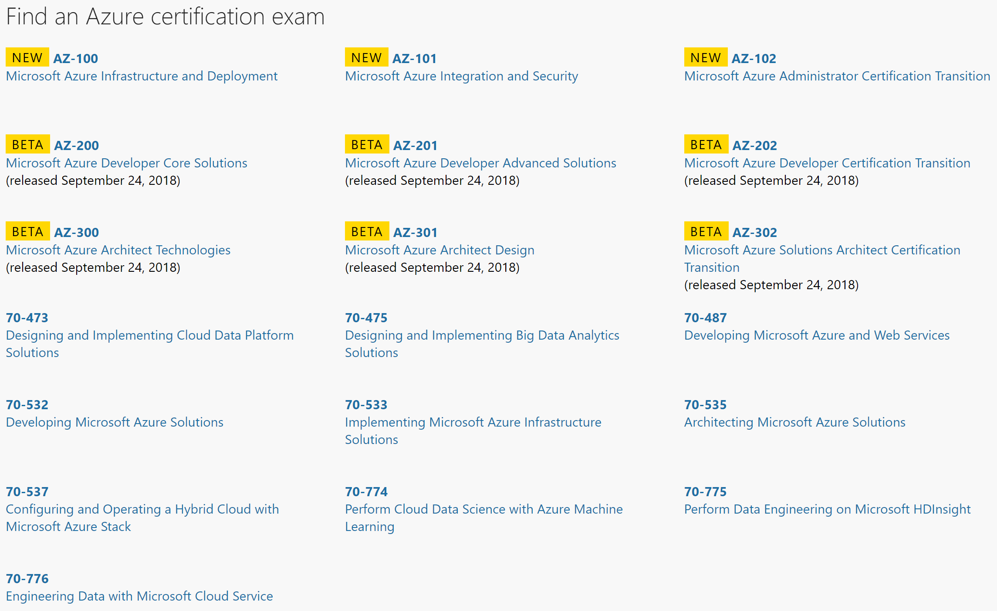
Azure Training and Certification
New Azure Certification Exams: https://www.microsoft.com/en-us/learning/azure-exams.aspx

Slide 7
Staying Current
azure.com/updates
azure.com/blog
azure.com/roadmap

Slide 8
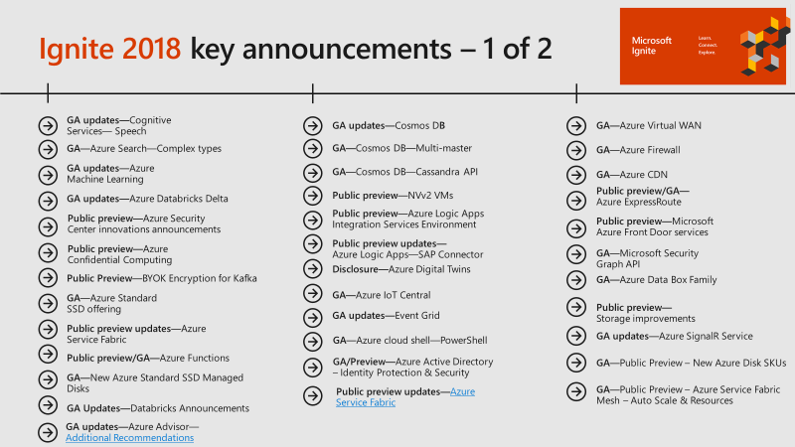
Notable updates

Slide 9
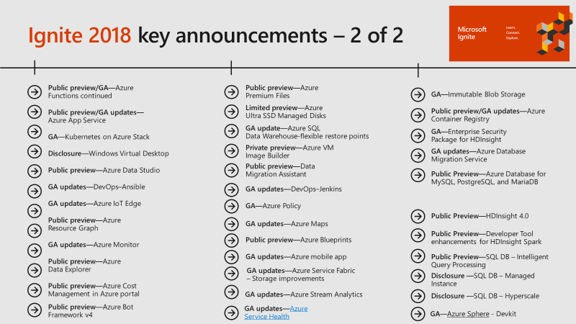
Notable updates

Slide 10
Chat Bots A more personal computing experience
Mike McKechney
mimcke@microsoft.com

Slide 11
Learning Goals
What is a bot?
Why chat bots?
How to build bots

Slide 12
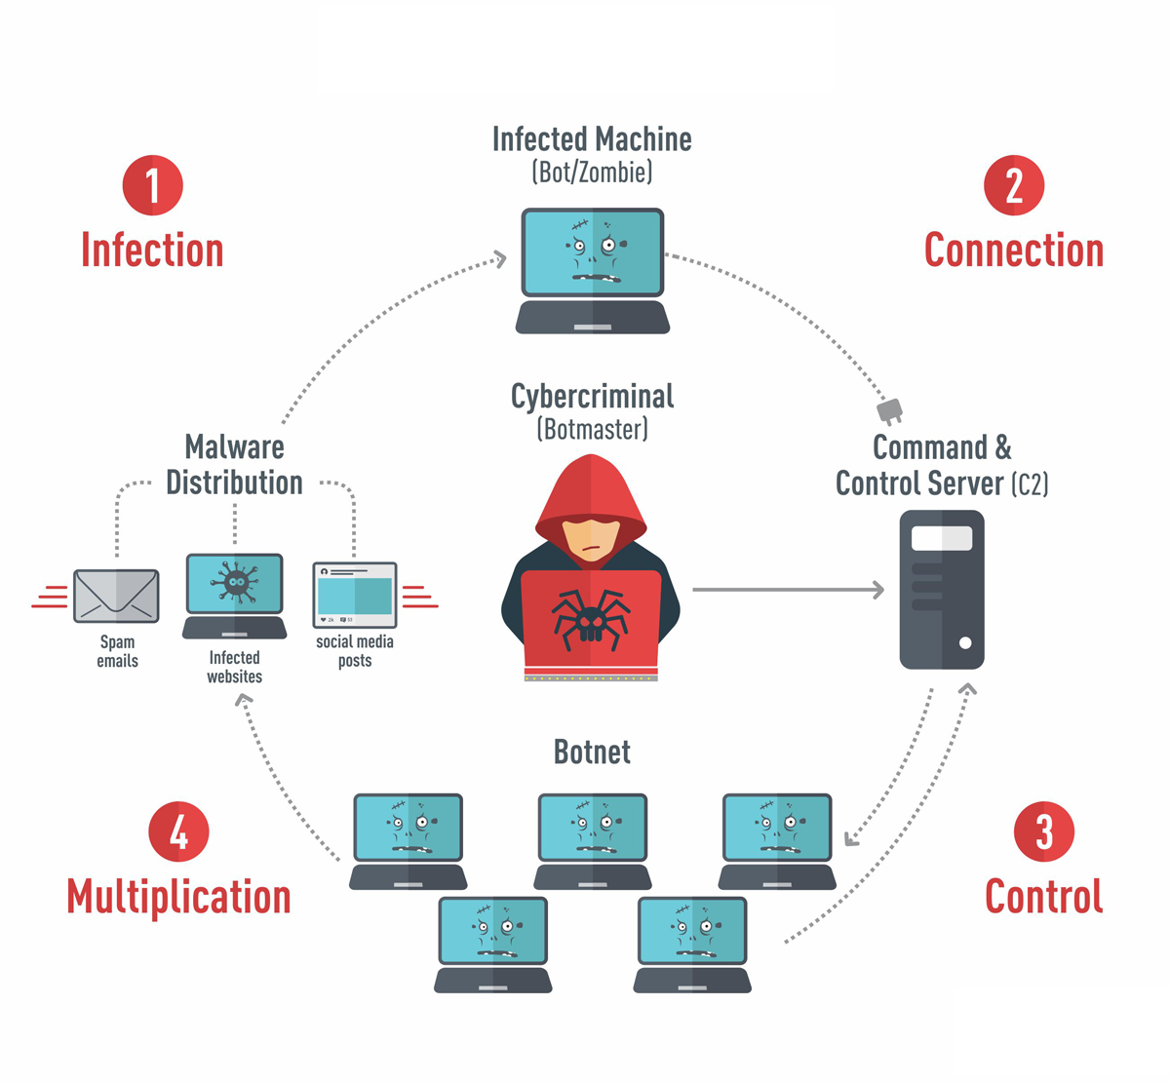
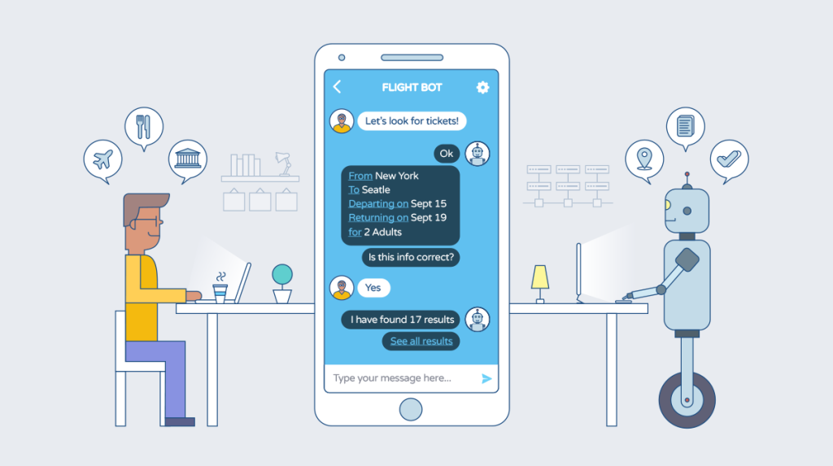
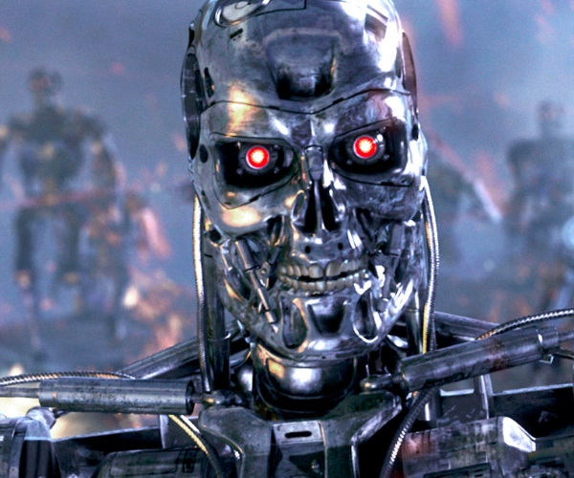
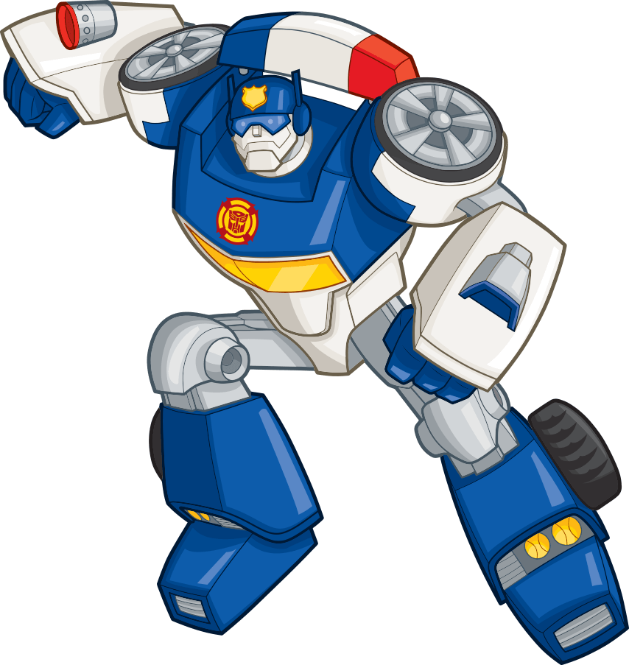
What is a bot?

Slide 13

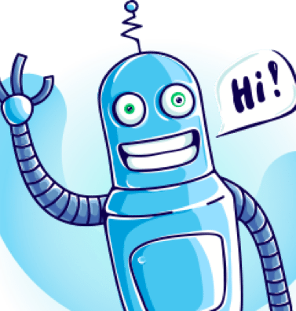
What is a bot?
An application that performs one or more automated tasks..
Bots uses conversation as the interface.
Conversational Apps are an application category of AI-based solution.

Slide 14

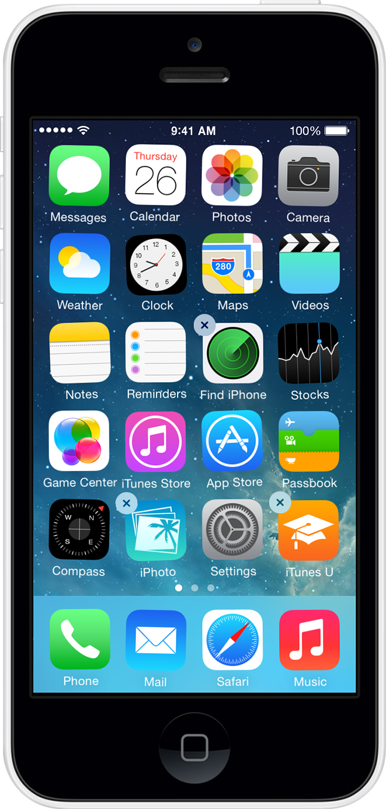
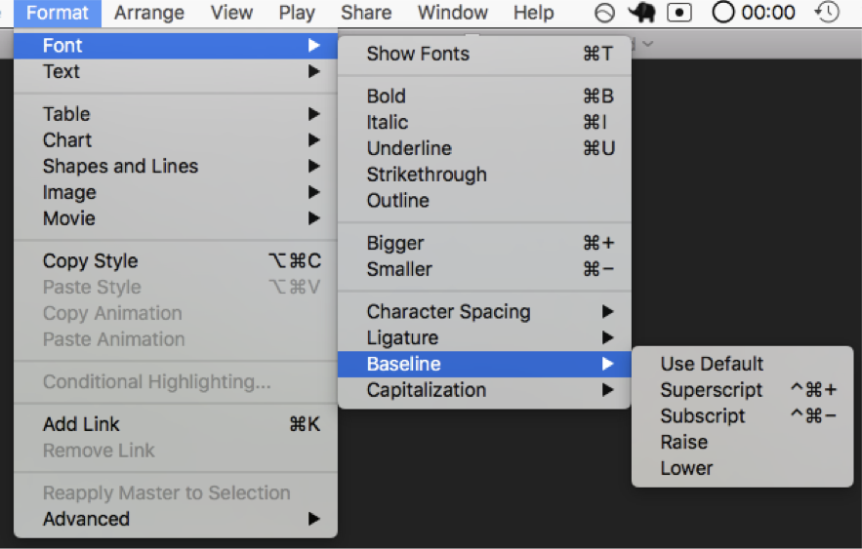
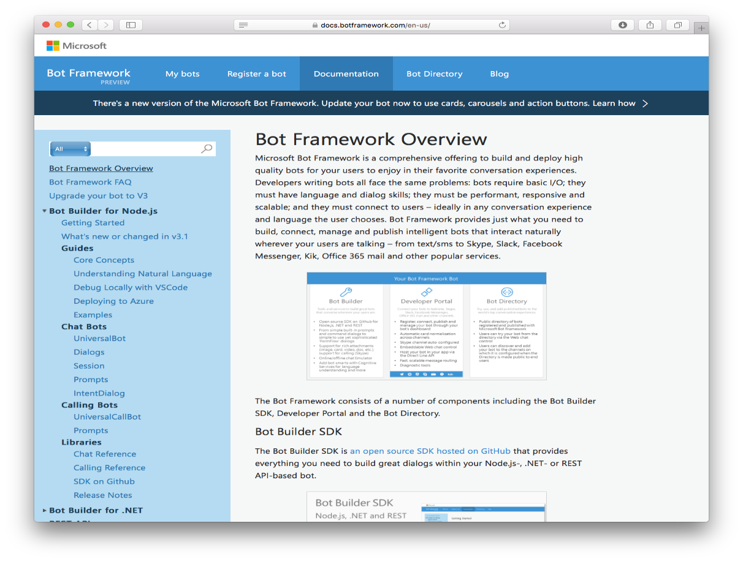
Why Chat Bots?
1990s: Internet
Search
User “visits” websites
IT’S YOUR JOB TO FIGURE OUT THE COMPUTER
1980s: PC
Desktop
2000s: Mobile
Social
User download apps from App Stores

Slide 15
The future: Conversations
Natural language between people and technology
Conversational canvas
Bots and agents
LET’S MAKE
THE COMPUTER FIGURE OUT YOU

Slide 16
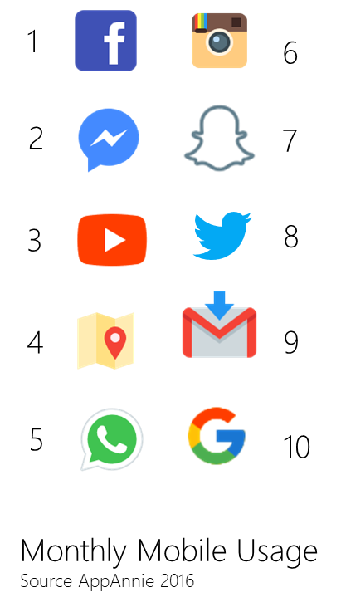
Why are chat bots important?
6 OF THE TOP 10 APPS USED ARE MESSAGING APPS

Slide 17
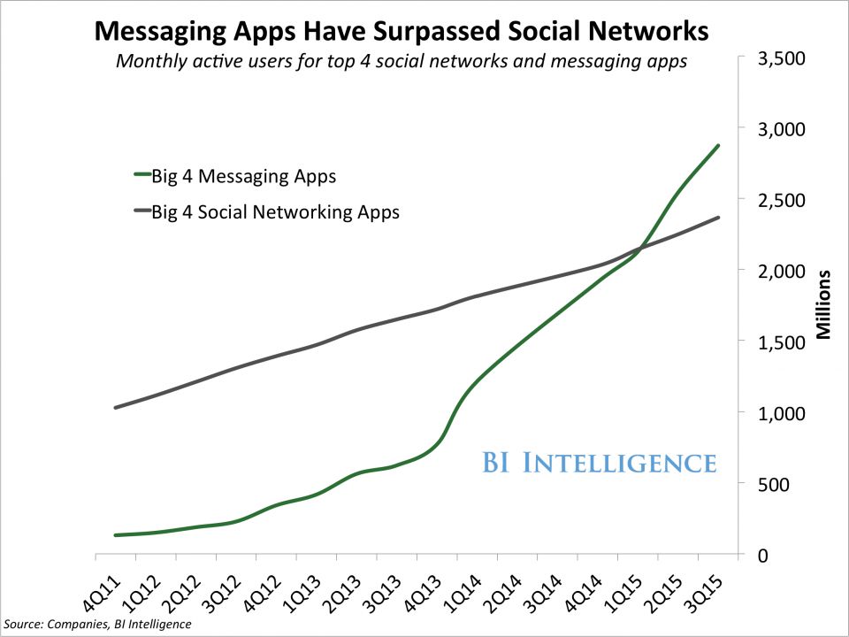
Why are chat bots important?

Slide 18
Examples of Conversational Apps
Internal Bots
Experiment and Learn
Simple Customer Bots
Unauthenticated Services
Advanced Bots
Authenticated Services
Internal Knowledge
Take existing FAQs and empower staff to provide self-serve knowledge via Bot.
General Enquiries
Handle basic customer enquiries traditionally hidden in FAQs.
Account Enquiry
Handle enquiries that require identification of the customer
(i.e., account balance enquiry)
IT Helpdesk
Report an IT problem and check the status. Bot can provide self-help and escalation to engineer if required.
Appointment Booking
Handle simple “anonymous” tasks via chat (i.e., booking an appointment)
Make Payment
Perform actions that require a user to be authenticated and authorized, e.g. make payment to predefined payee.
Smart Document Agent
Search of relevant documents based on the user’s needs.
Complex Enquiries
For requests that a Bot cannot complete hand off to a human agent.
Retail-bot
Send a customer with a new device to a stall to help them set up their services.

Slide 19
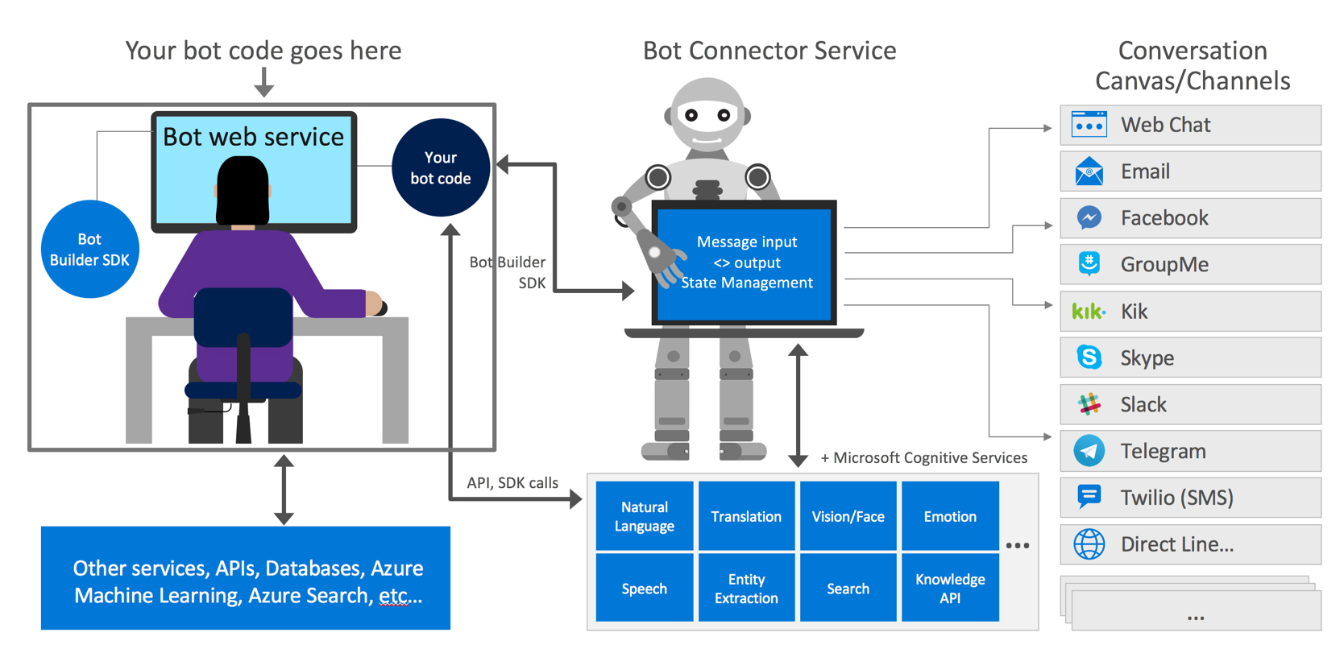
Microsoft Bot Framework

Slide 20

DEVELOPMENT ENVIRONMENT Microsoft Bot Framework

Slide 21






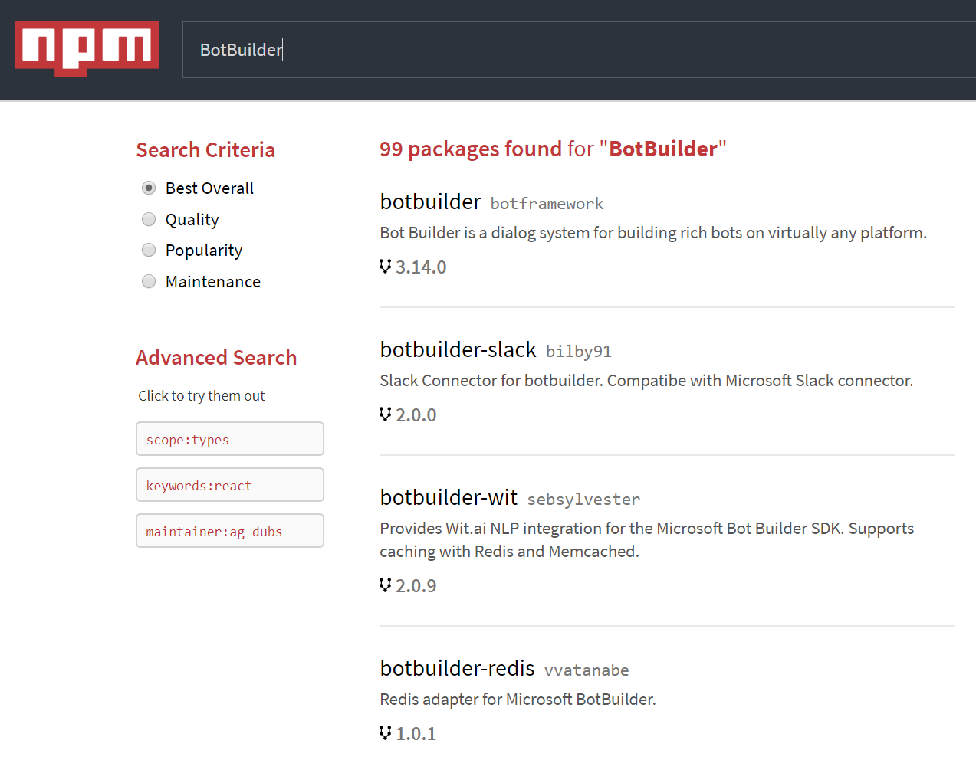
BotBuilder SDK
BotBuilder SDK is a developer focused solution
Open-Source
250k+ Developers
BotBuilder SDK V4
Now GA
Open Source
Thriving Ecosystem
Community Engagement

Slide 22
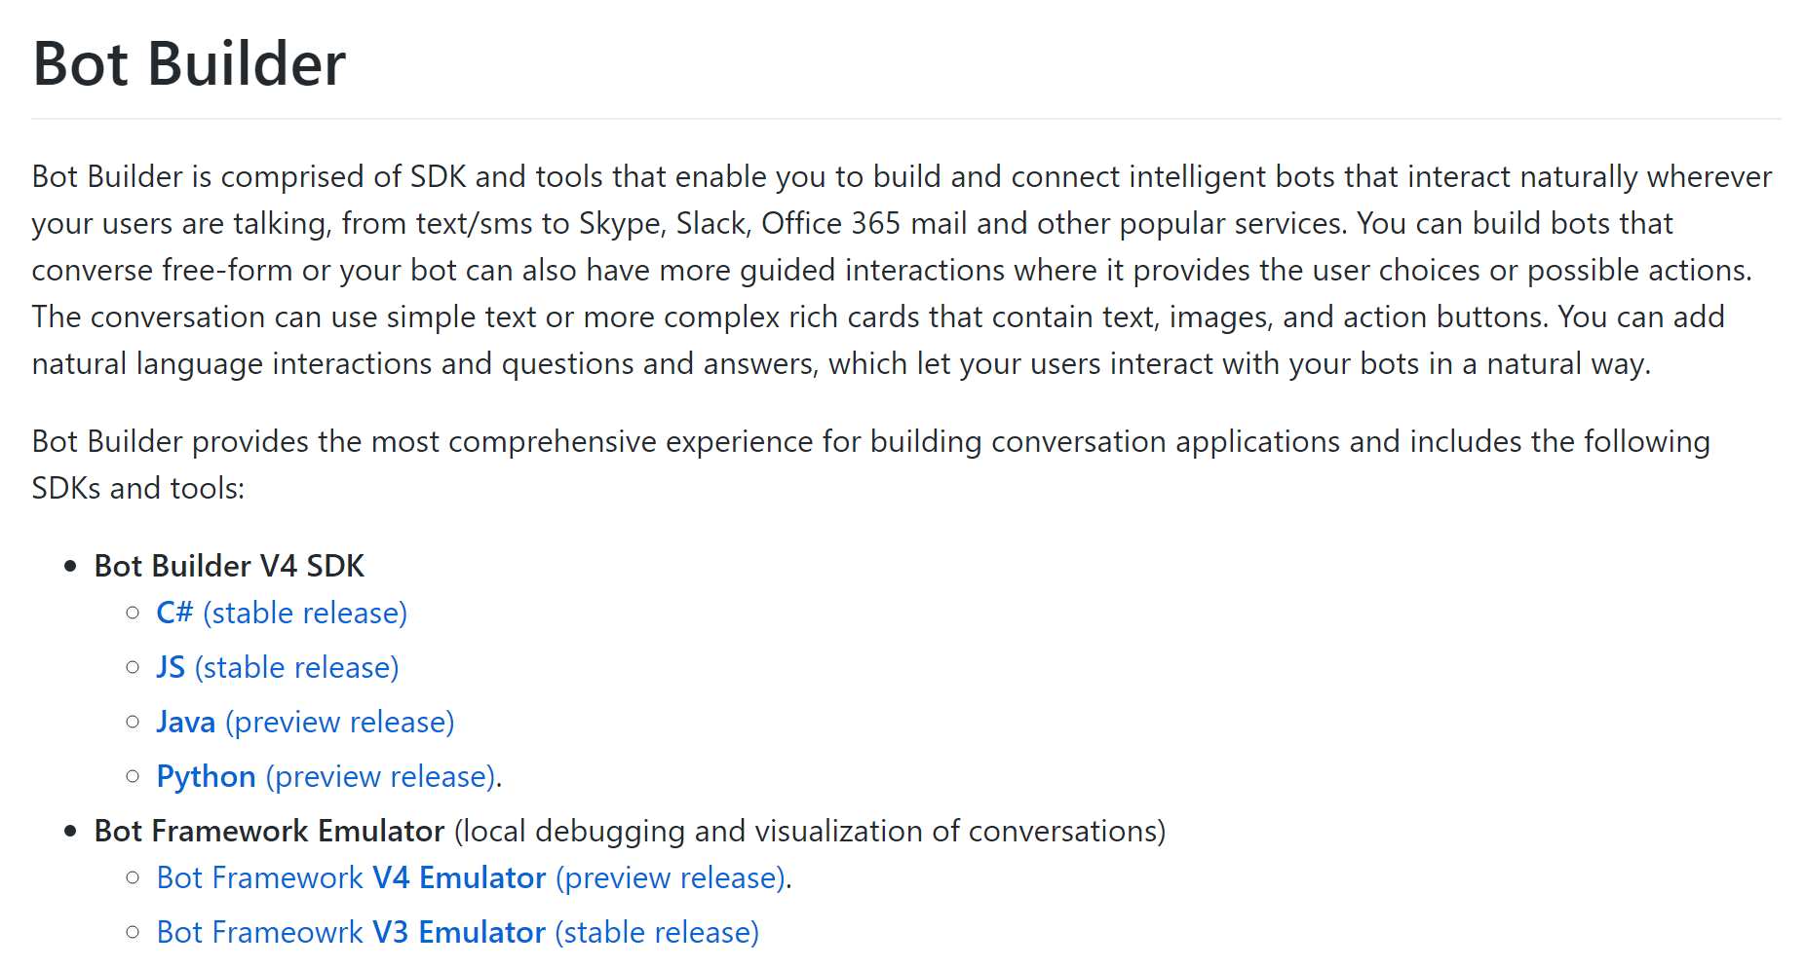
Open Source on Git Hub
https://github.com/Microsoft/BotBuilder

Slide 23
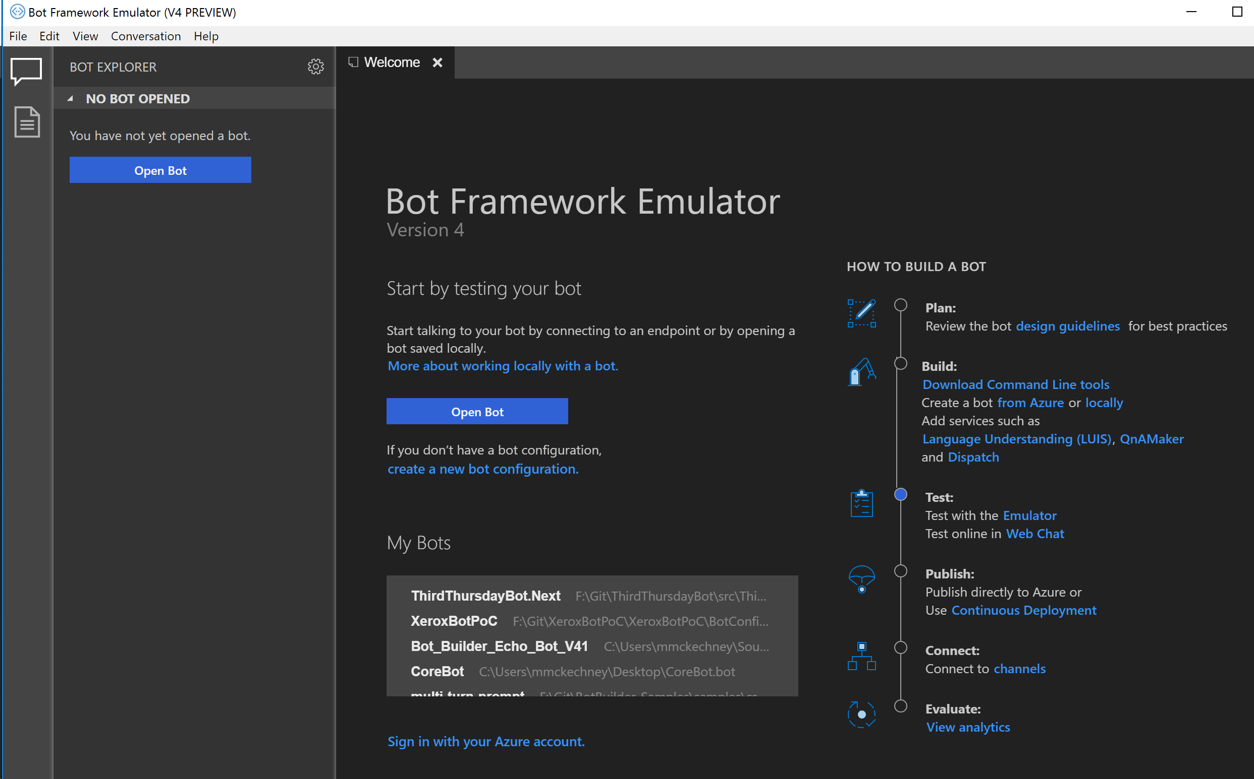
Bot Framework Emulator
https://github.com/microsoft/botframework-emulator

Slide 24
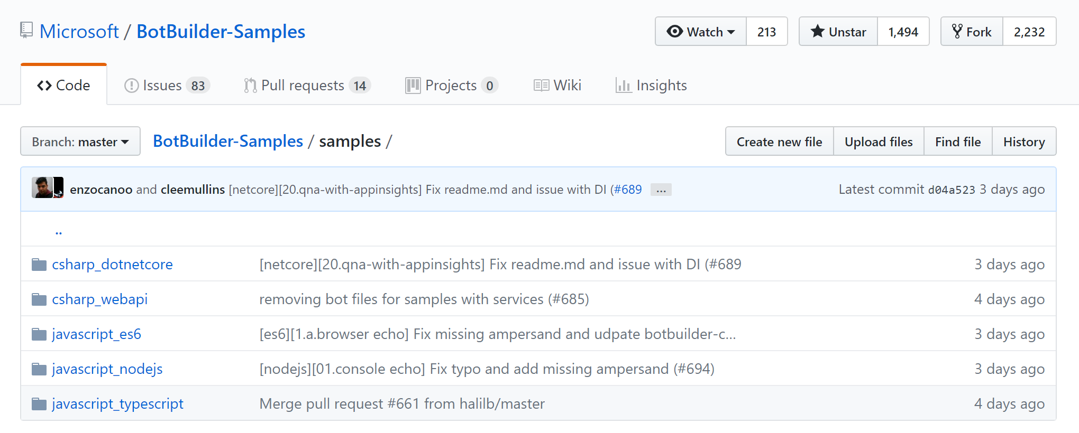
Lots of Samples!
https://github.com/Microsoft/BotBuilder-Samples

Slide 25
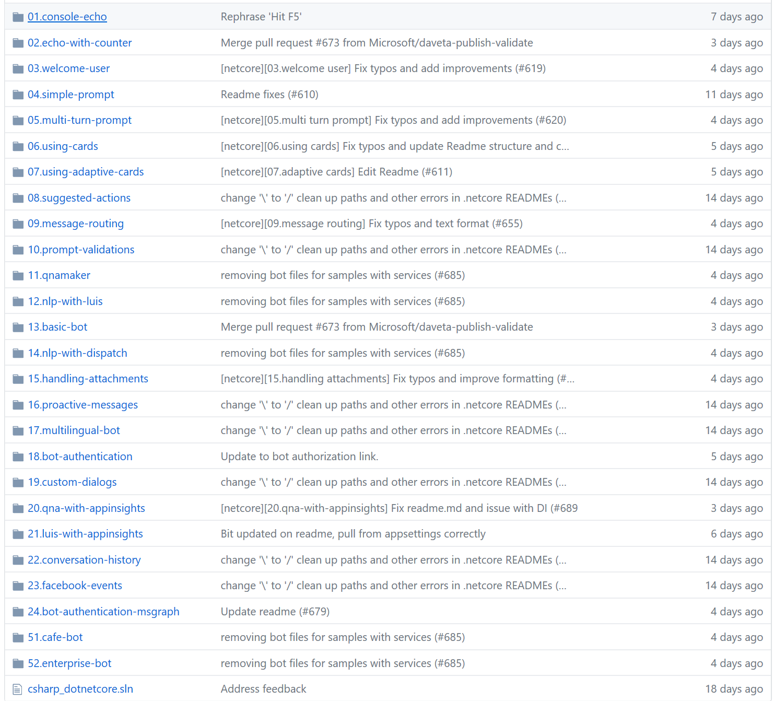
26 use cases covered

Slide 26
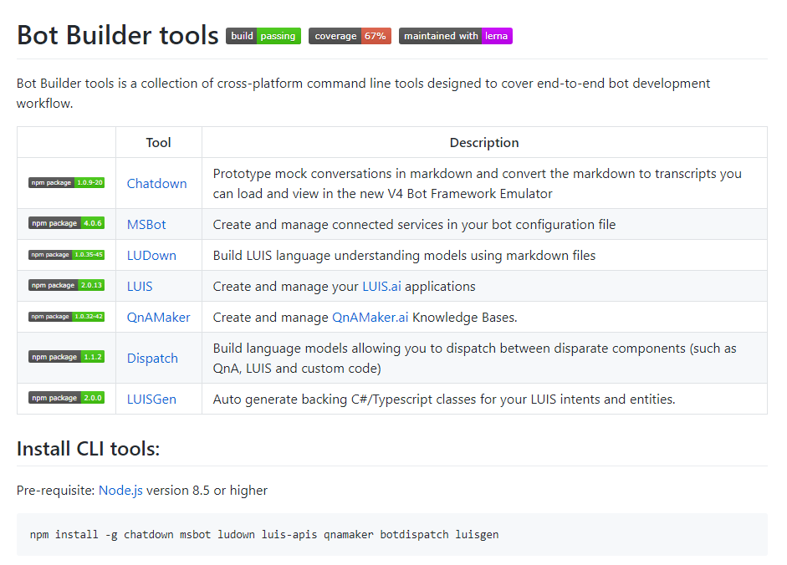
Automation tools

Slide 27
DEVELOPMENT ENVIRONMENT Microsoft Bot Framework

Slide 28
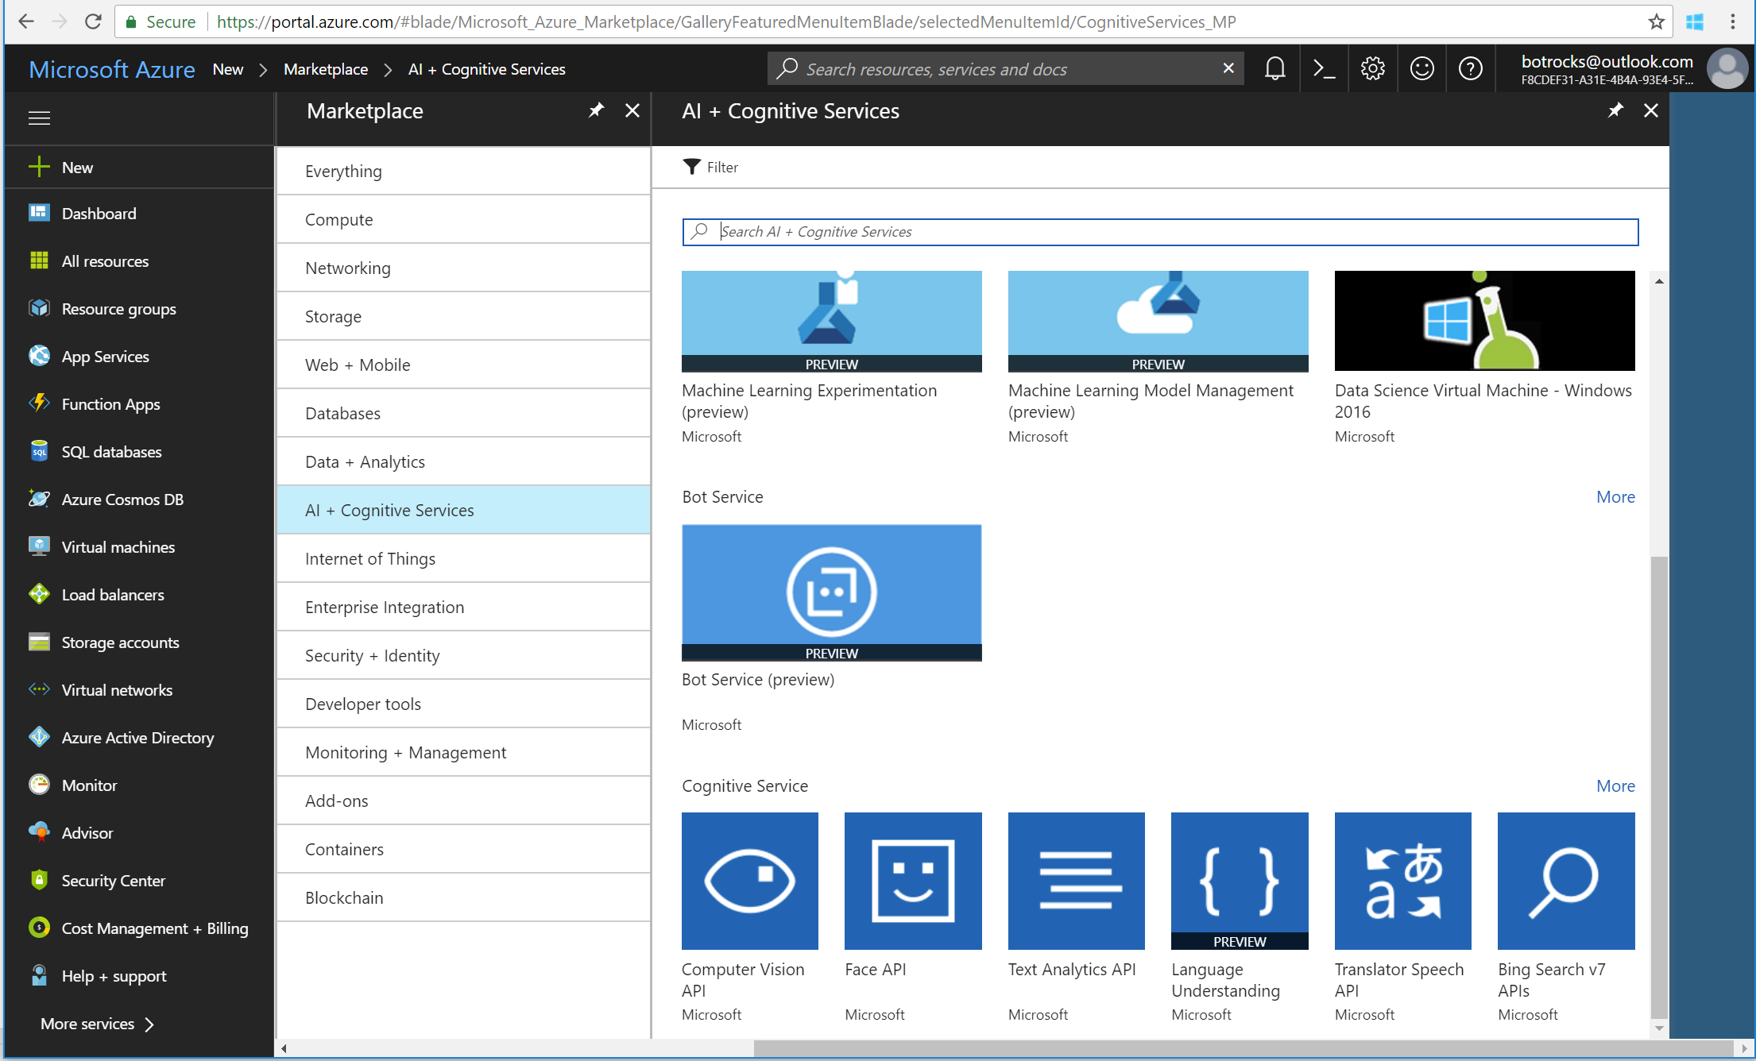
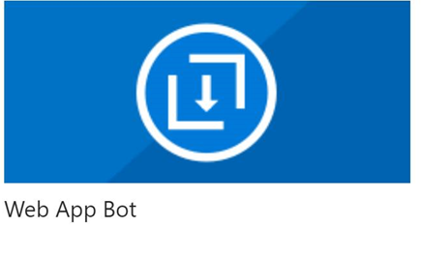
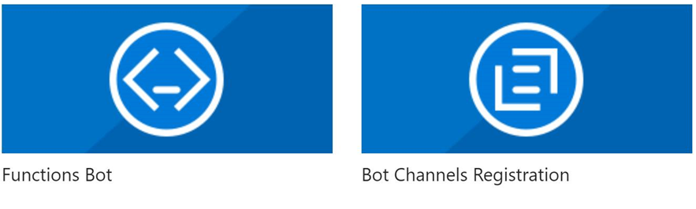
Add channels to your bot

Slide 29
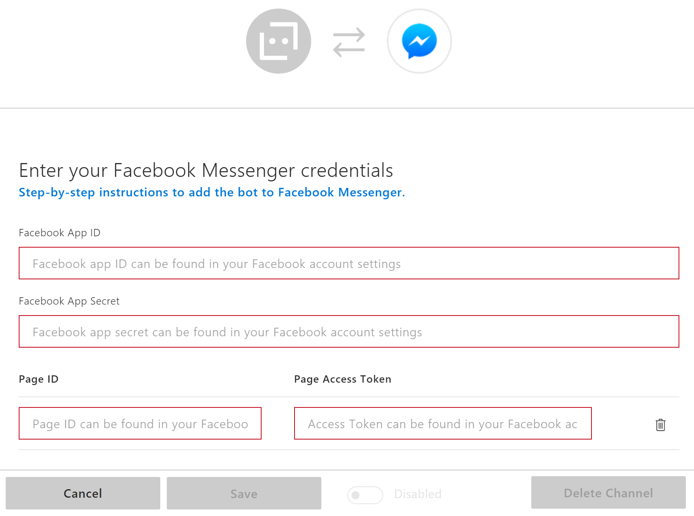
Register channel

Slide 30
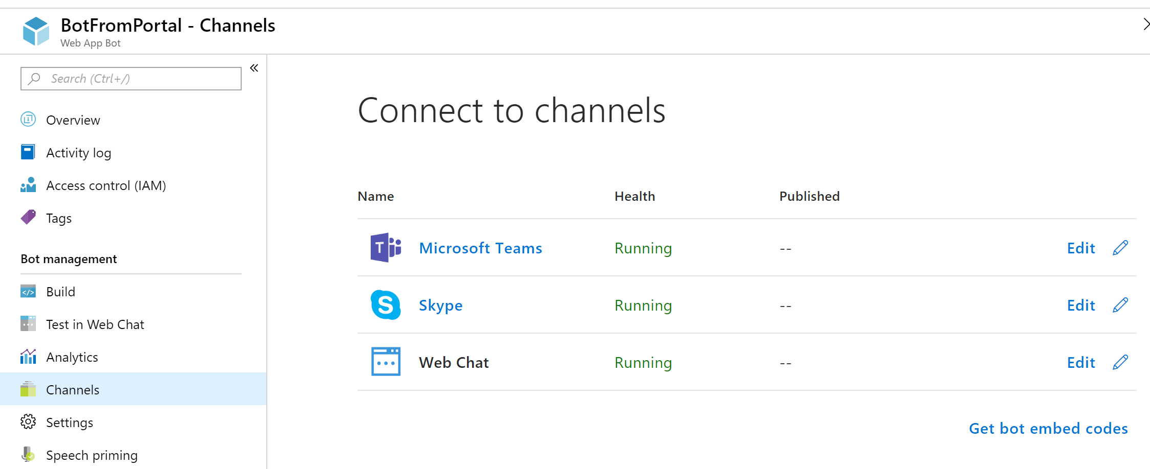
Manage channels and view health

Slide 31
DEVELOPMENT ENVIRONMENT Microsoft Bot Framework

Slide 32
BREADTH Conversational AI tools
Language Understanding Intelligent Service
Azure Search
QnA Maker
Teach your apps to understand commands from your users
Integrate search into a conversational experience
Distill information into conversational, easy-to-navigate answers
Bing Speech API
Speaker Recognition API
Translator
Custom Speech Service
Convert speech to text and back again, and understand its intent
Give your app the ability to know who's talking
Easily perform speech and text translation
Fine-tune speech recognition for anyone, anywhere

Slide 33
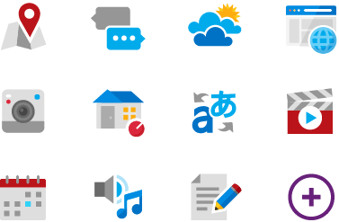

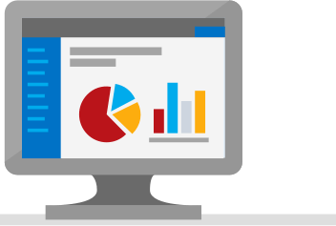
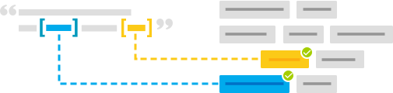
BREADTH Language Understanding (LUIS)
Machine learning-based service to build natural language into apps, bots, and IoT devices. Quickly create enterprise-ready, custom models that continuously improve
Add natural language to your apps
Quickly build a custom language solution
Always learning and improving
Enterprise-ready, available worldwide
Designed to identify valuable information in conversations, LUIS interprets user goals (intents) and distills valuable information from sentences (entities), for a high quality, nuanced language model.
Custom Models can be created based on the same technology in Azure Machine Learning.
Leverages customizable pre-built apps and entity dictionaries, (e.g., Calendar, Music, Devices).
Dictionaries are mined from the collective knowledge of the web and supply billions of entries, helping your model to correctly identify valuable information from user conversations.
LUIS integrates seamlessly with the Azure Bot Service, making it easy to create a sophisticated bot.
Active learning is used to continuously improve the quality of the natural language models.
Once the model starts processing input, LUIS begins active learning, allowing you to constantly update and improve the model.
The service is ready to be deployed in commercial applications and can scale with enterprise quality and performance.
The service meets international compliance standards, supports 13 languages and available worldwide, making it highly accessible around the world

Slide 34
DEVELOPMENT ENVIRONMENT Microsoft Bot Framework

Slide 35















UX SUPPORT Channels
WebChat
DirectLine

Slide 36
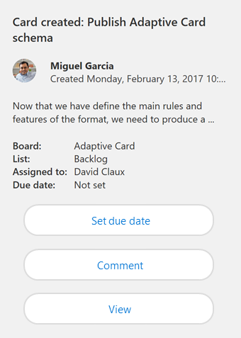
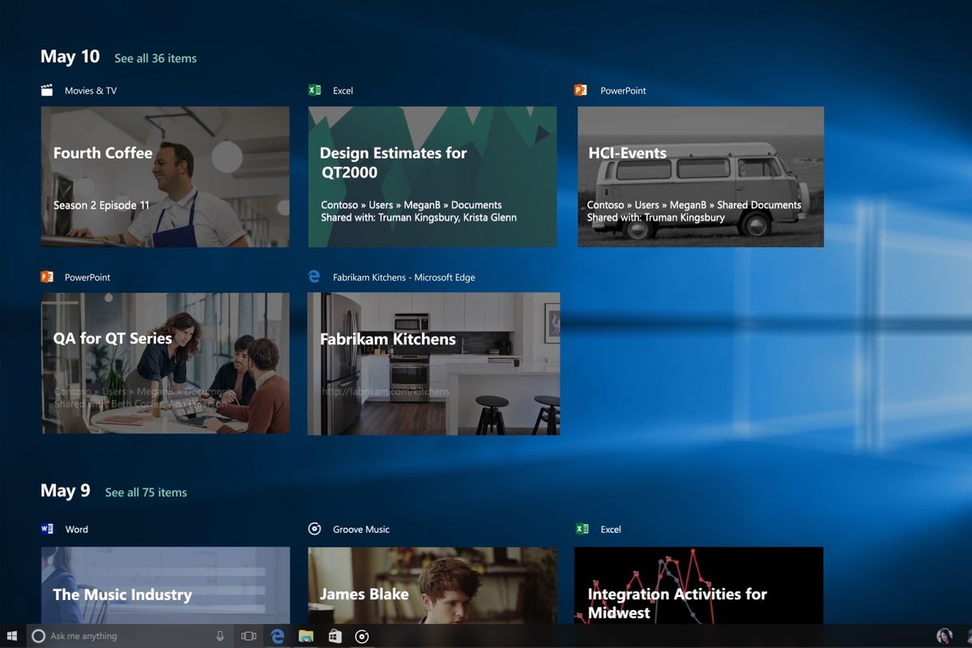
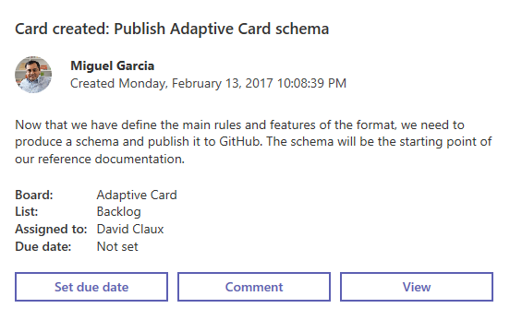
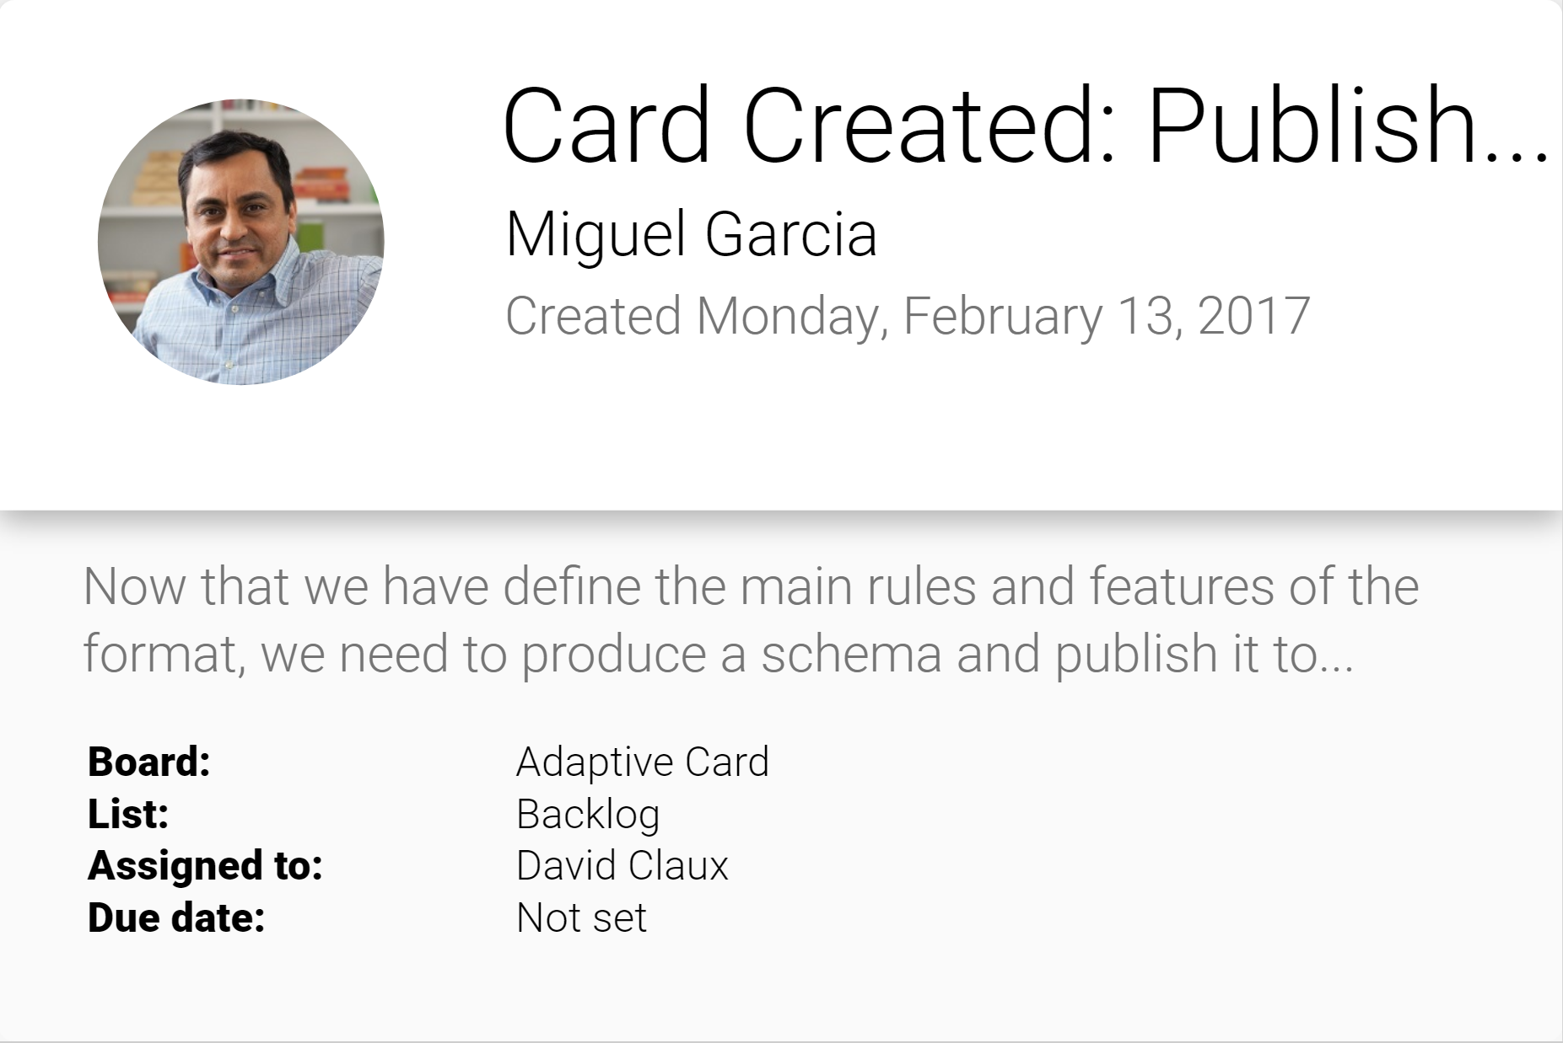
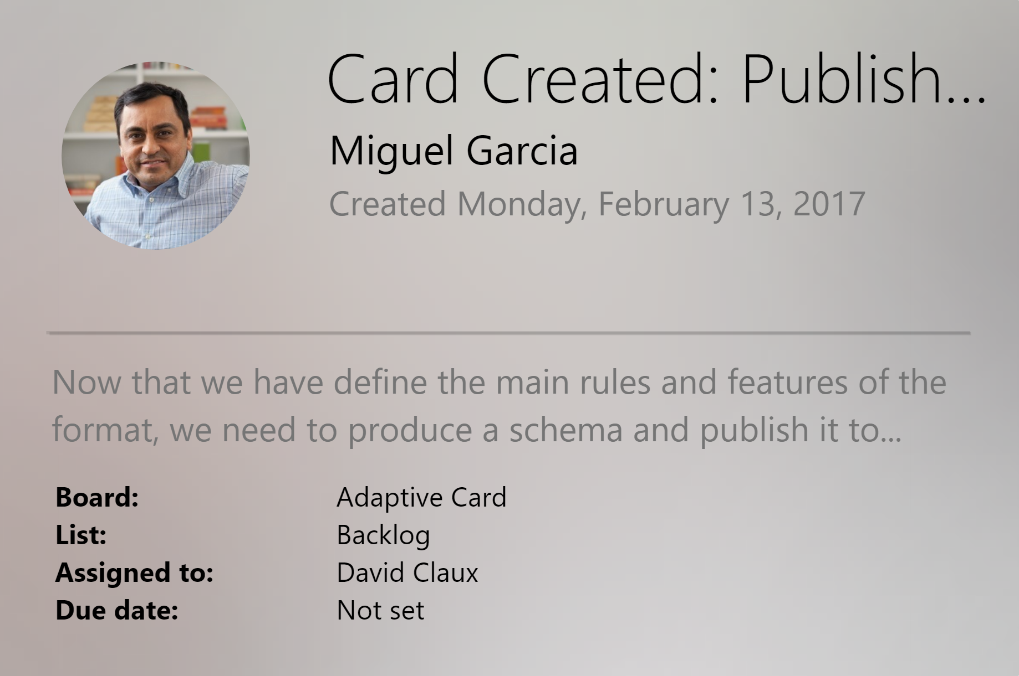
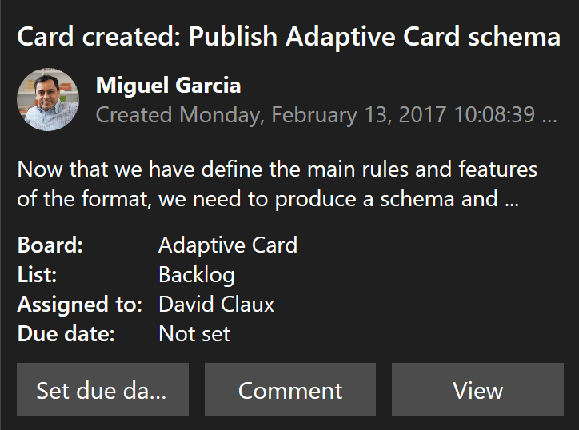
UX SUPPORT Adaptive cards
Open framework, multiple canvases
Windows
Productivity- Microsoft Teams
Skype
Android
iOS

Slide 37
DEVELOPMENT ENVIRONMENT Microsoft Bot Framework

Slide 38
Conversational AI
Bot Framework
Bot Builder
Open source
SDK: node, C#, Python, Java, and Tooling
Build and publish anywhere
Azure Bot Service
Provision your bot, with storage and analytics
Web app or serverless/function
Publish to channels (Skype, Facebook, etc.), Direct Line, web chat
ISO 27001, 27018, and PCI compliant
Channels
Connect a bot built using Bot Builder or other tool, hosted on Azure, or anywhere
First-party: Skype, Teams… Web Chat, Direct Line
Third-party: Slack, Facebook, Twilio
Conversation/ Bot Component
Answer questions (e.g., FaQ: QnA)
Forms
Query over custom database: Azure search
Graphical user interface (e.g., cards and buttons): adaptive cards
Language models: LUIS, semantic dictionary
Spoken language: custom speech
Real-time translation
Spell check for language input: Bing speller
Prebuilt domains for common content types: Cortana Models and time, numbers, places, etc.
Dispatch
Ability to integrate third-party components from any other company

Slide 39
Demo

Slide 40
Learning Goals
What is a bot?
Why chat bots?
How to build bots

